Slide 1
Simple Weather App using ReactJS _____________________________
A lightweight, clean and colorful weather application
Presented by: Shivam Gupta
Date: 31/07/2025

Slide 2
What is this App?
A simple weather application
User can search for any city
Displays temperature, humidity, wind speed, and description
Fully functional and visually appealing

Slide 3
Tech Stack Used
ReactJS: For building the UI
Axios: For making API requests
OpenWeatherMap API: To fetch weather data
CSS: For styling and layout (no Tailwind or extra libraries)

Slide 4
App Features
User inputs a city name
Fetches live weather from OpenWeatherMap API
Displays: Temperature (in Celsius), Weather description, Humidity and Wind speed
Basic error handling (e.g., city not found)

Slide 5
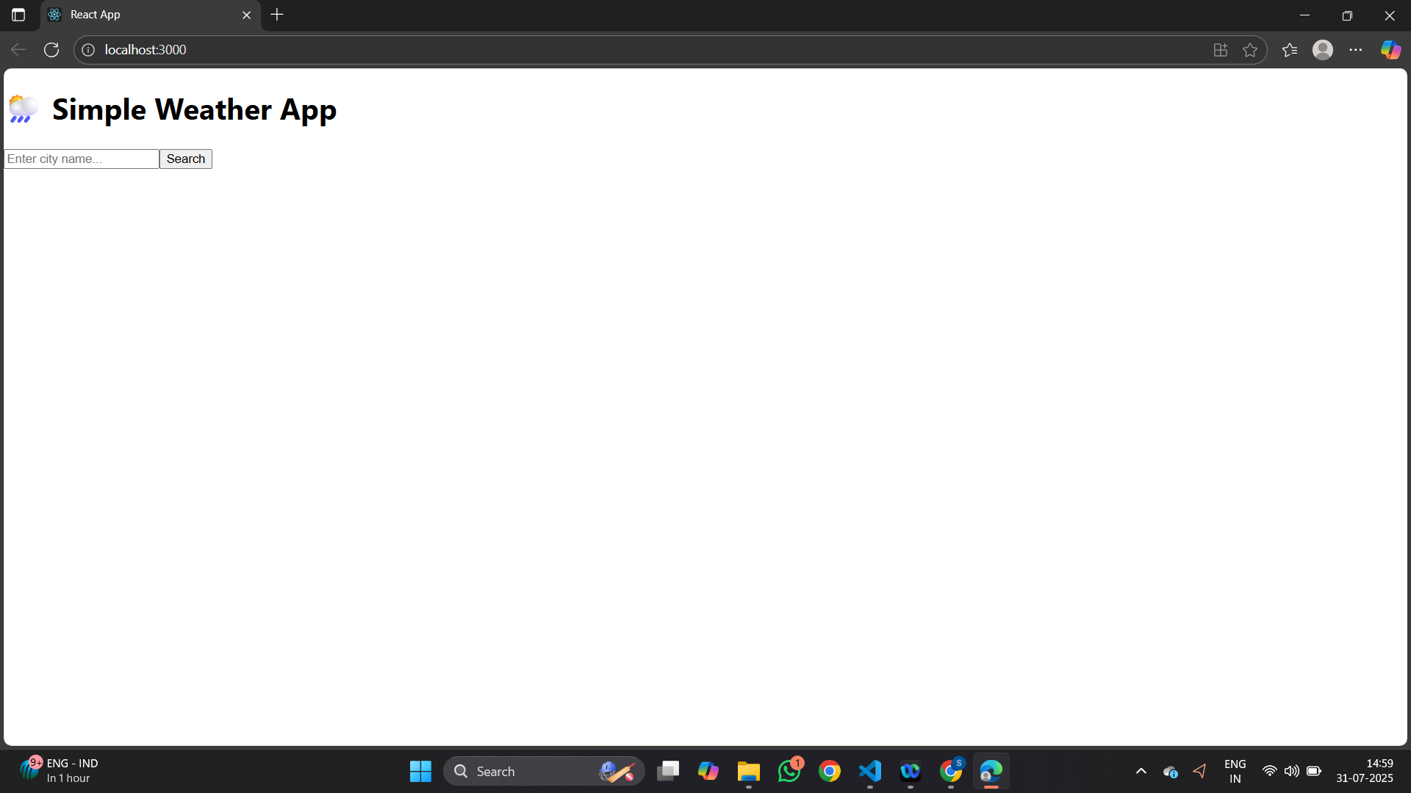
Output Demo (Initial view)

Slide 6
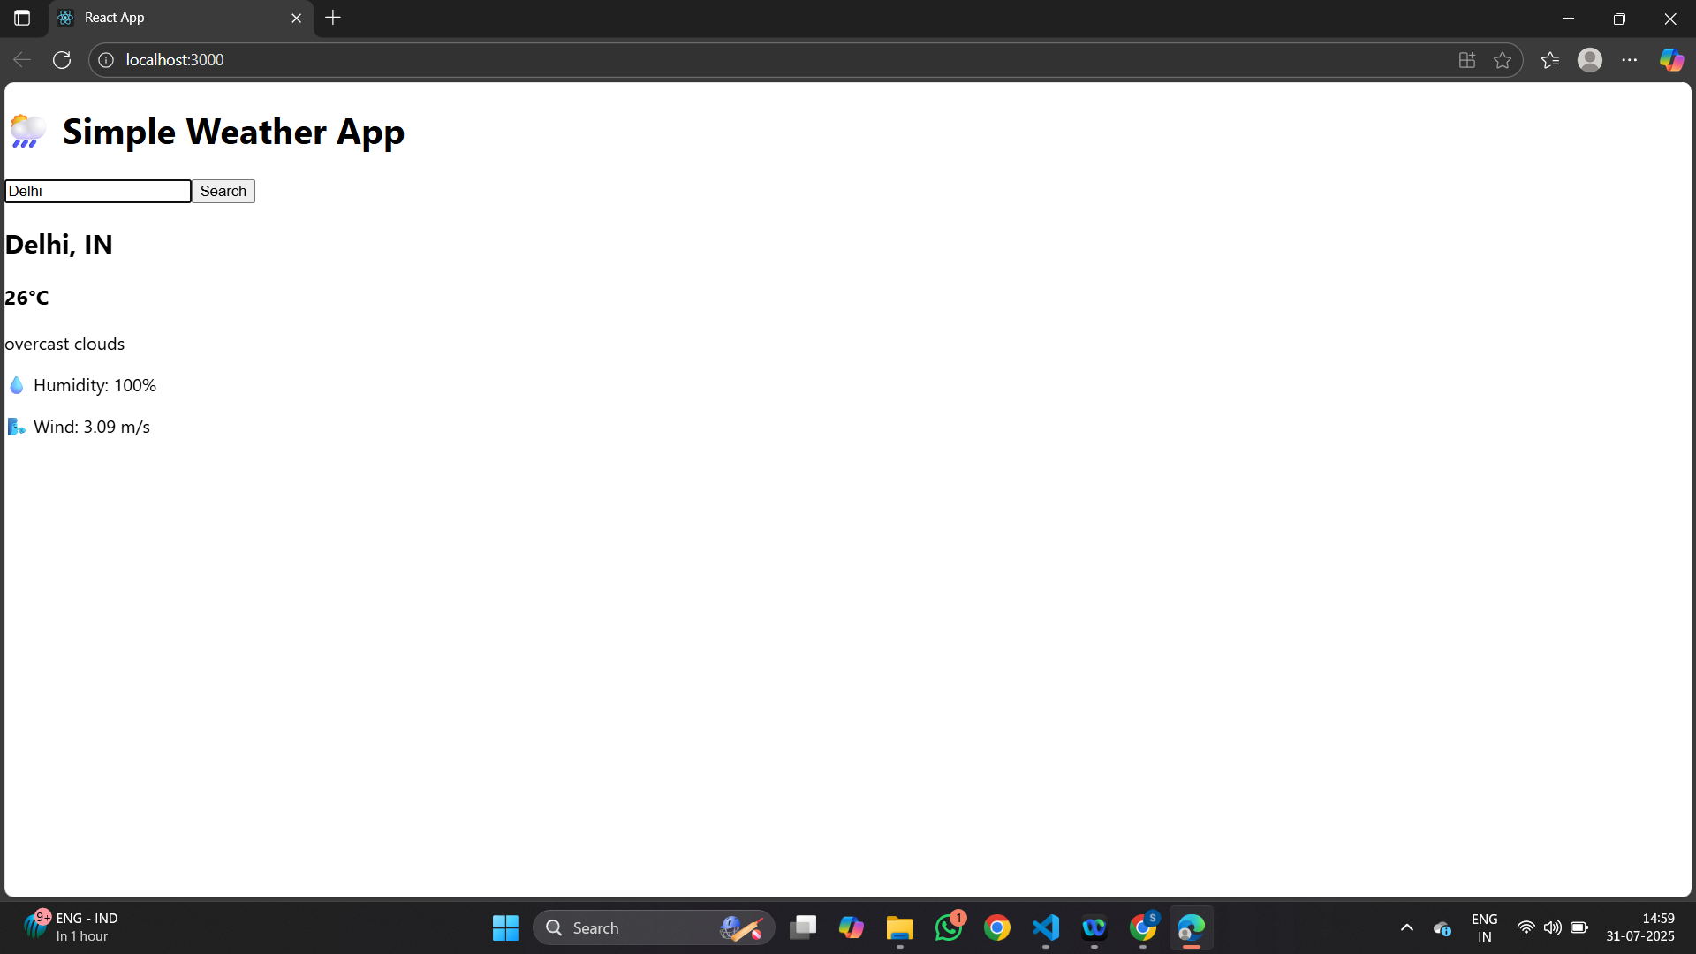
Output Demo (After searching)

Slide 7
Code Structure
All logic and UI in a single file: App.js
Additional styling in App.css
No .env file used (API key is directly in App.js)
Lightweight and easy to maintain

Slide 8
API Call Logic
Used axios.get() to fetch data
URL format: https://api.openweathermap.org/data/2.5/weather?q=CITY&appid=API_KEY&units=metric
Handled loading and error states

Slide 9
Future Scope
Add 5-day forecast support
Display background images based on weather
Add weather icons
Show real-time clock and local timezone info

Slide 10
Thank You!

